Slide 1
Sequences and Time-Series in Medicine July 25, 2020
Applied Data Science
MMCi Term 4
Matthew Engelhard
Notes:
NEED INFO ABOUT ROC, CONFUSION MATRIX, ETC HERE

Slide 2
The Easy Case… WE just evaluate performance
Sequential Models in Practice

Slide 3
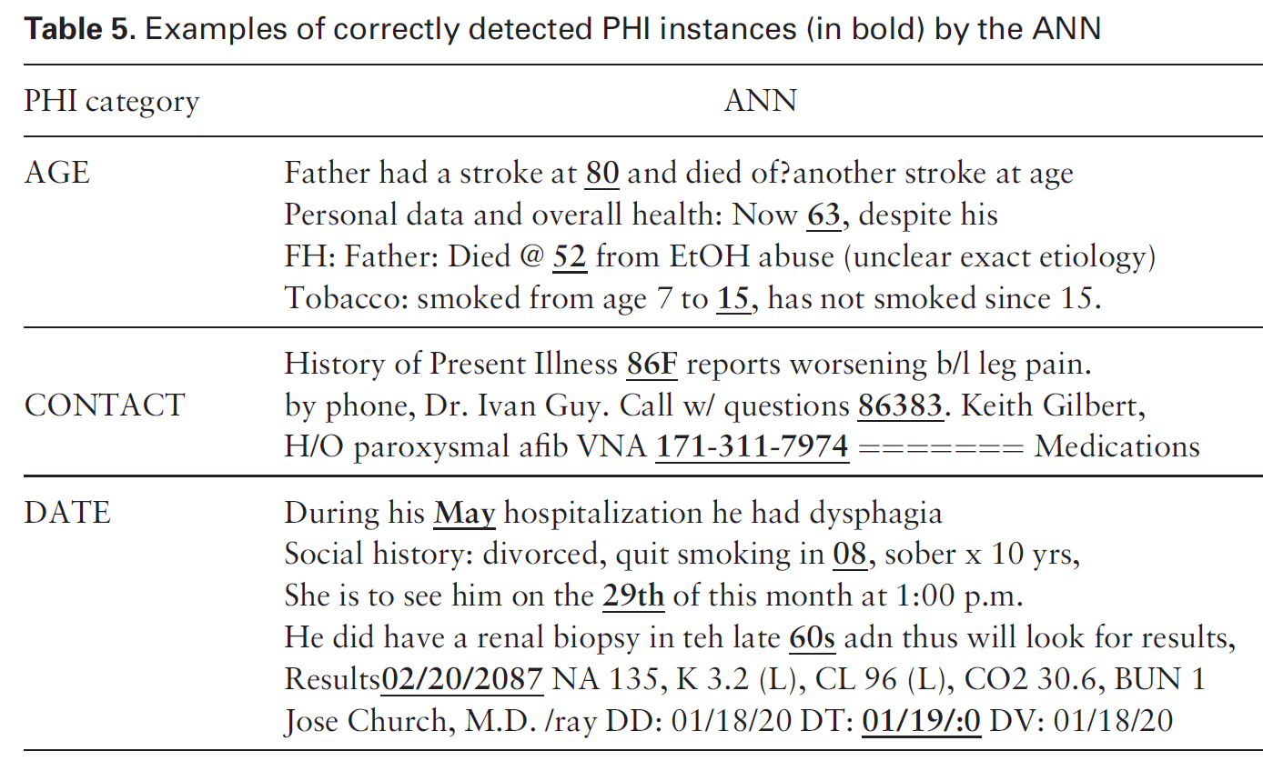
Deidentification of Patient Notes
A bidirectional RNN is used to identify PHI (18 HIPAA fields)
i2b2: 889 discharge summaries, >28k PHI tokens
MIMIC: 1635 discharge summaries, >60k PHI tokens
State of the art sensitivity and F1 metric on both datasets
De-identification of patient notes with recurrent neural networks
Dernoncourt F, Lee JY, Uzuner O, Szolovits P
JAMIA 24(3), 2017, 596–606
Notes:
Deidentification is a big challenge
Ideally want 100% sensitive removal of PHI, but there’s a huge amount to identify and human rates are pretty low when done at scale
Expert systems out there – manually curated rule-set – that does this
The idea – we want to use an RNN approach – very similar to the one David described – to do this
Use two datasets, including one generated specifically for this task based on discharge summaries coming from MIMIC
Point out that they say ANN instead of RNN

Slide 4
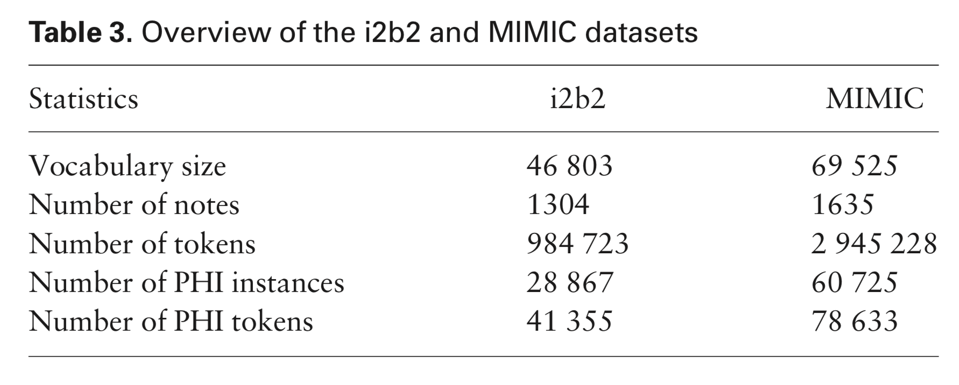
Train, Validation, Test
MIMIC:
80% train/validation
20% test
i2b2:
60% train/validation
40% test
“All results were computed using the official evaluation script from the i2b2 2014 de-identification challenge.”

Slide 5
Examples of PHI Identified by the RNN

Slide 6
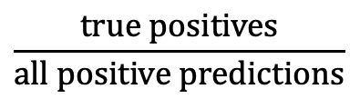
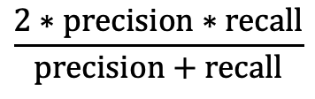
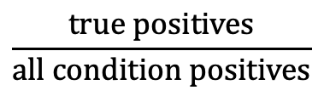
Evaluation Metrics
Precision, or positive predictive value:
Recall, or sensitivity:
F1-score:
 | Condition Positive | Condition Negative
Prediction Positive | True Positive | False Positive
Prediction Negative | False Negative | True Negative
$$\frac{true positives}{all positive predictions}$$
$$\frac{true positives}{all condition positives}$$
$$\frac{2∗precision∗recall}{precision+recall}$$
Notes:
F1-score is harmonic mean of the two

Slide 7
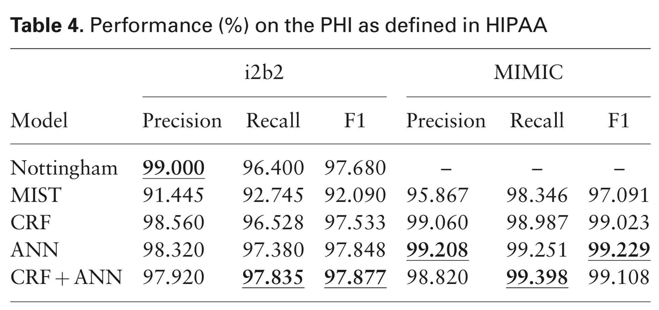
RNN Model Outperforms Previous Benchmarks
Notes:
Note that Nottingham incorporates expert system, dataset-specific elements

Slide 8
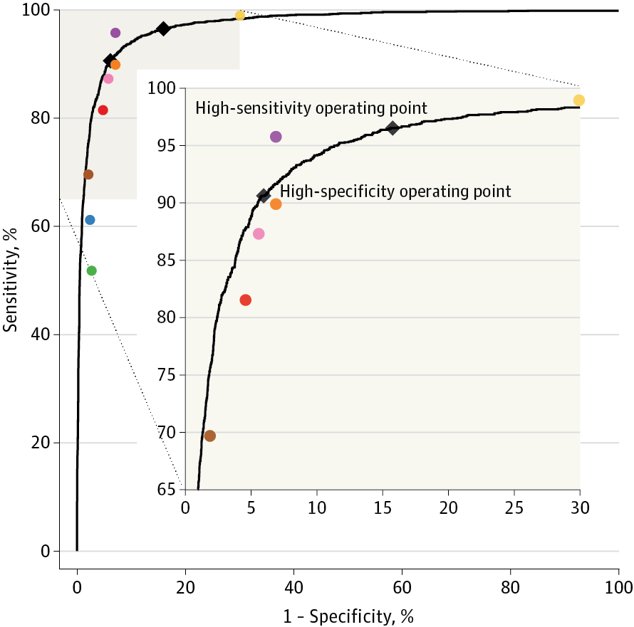
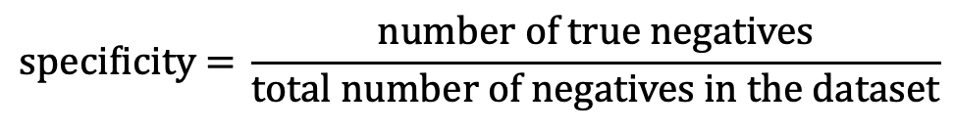
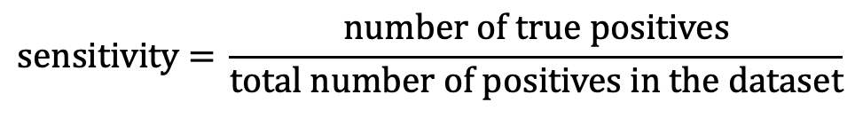
Deep Learning for Diabetic Retinopathy Classification
$$\text{sensitivity}\text{ = }\frac{\text{number} \text{of} \text{true} \text{positives}}{\text{total} \text{number} \text{of} \text{positives} \text{in} \text{the} \text{dataset}}$$
$$\text{specificity}\text{ = }\frac{\text{number} \text{of} \text{true} \text{negatives}}{\text{total} \text{number} \text{of} \text{negatives} \text{in} \text{the} \text{dataset}}$$
Choose an operating point:
Are we more concerned about false positives, or false negatives?
Gulshan et al. JAMA (2016)
Notes:
Talk thru sensitivity and specificity . Add that this is an advertisement for Matt. Add 2x2 table…maybe show moving a threshold. Add equation. Say that with sensitivity, “the higher the better”, and with 1- Specificity, also higher is better, but here is 1- specificity, so lower is better. Start with a different graph to explain. Animate so that after I state, superimpose human performance, add human points. Keep the message simple. The CNN is doing better than 80% of the physicians. Animate the inset

Slide 9
“ground truth” in Model EValuation
Sequential Models in Practice

Slide 10
Predict Hypoxemia during Surgery
Hypoxemia
SpO₂ ≤ 92%
Cardiac Arrest and Arrhythmias
Delirium and Decreased Cognitive Function
Infections and Poor Wound Healing
Notes:
BASED ON A COMBINATION OF INITIAL AND REAL-TIME / TIME-VARYING FEATURES AVAILABLE THROUGH THE ANESTHESIA INFORMATION MANAGEMENT SYSTEM (AIMS)
Hypoxaemia: decrease in SpO₂, that is, arterial blood oxygen saturation as measured by pulse oximetry, to a threshold value of 92% or lower
Real-time blood oxygen monitoring through pulse oximetry only allows anaesthesiologists to take reactive actions to minimize the duration of hypoxemic episodes after their occurrence
Hypoxaemia is associated with cardiac arrest, cardiac arrhythmias, post-operative infections and wound healing impairments, decreased cognitive function and delirium, and cerebral ischaemia through a number of metabolic pathways⁷. Despite the advent and use of pulse oximetry to continuously monitor blood oxygen saturation (SpO₂) during general and regional anaesthesia, hypoxaemia can neither be reliably predicted nor prevented at future time points

Slide 11
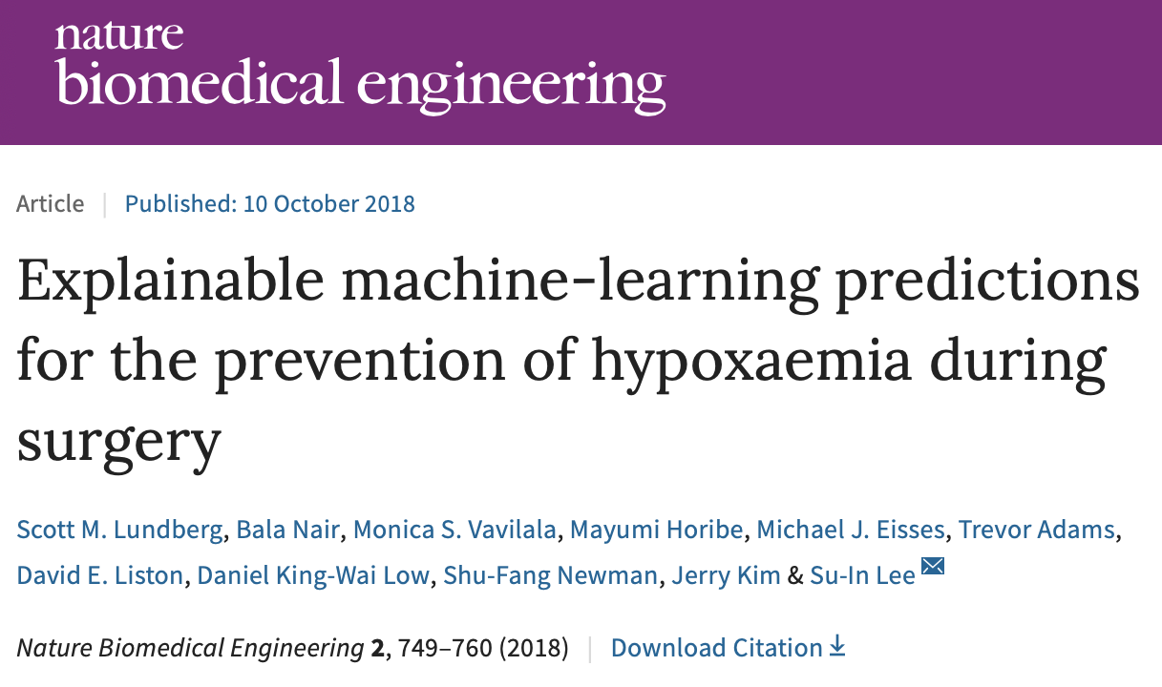

Slide 12
Comparison to Experts
For initial risk prediction:
Anaesthesiologists performed significantly better with Prescience (AUC = 0.76 versus 0.60; P < 0.0001)
Prescience performed better in a direct comparison with anaesthesiologists (AUC = 0.83; P < 0.0001)
For intraoperative real-time (next 5 min) risk prediction:
Anaesthesiologists (AUC = 0.66) again performed better with Prescience (AUC = 0.78; P < 0.0001)
Prescience alone outperformed anaesthesiologists predictions (AUC = 0.81; P < 0.0001)
Notes:
anaesthesiologists were asked to provide a relative risk of hypoxaemia compared to a normal acceptable risk, for example, 0.01 for one-hundredth of the normal risk or 3.4 for 3.4 times the normal risk. These relative risks were then used to calculate standard receiver operating characteristic (ROC) curves averaged over five anaesthesiologists
Light colored lines are individuals; dark lines are average
As usual, highlight false alarm / missing tradeoff, which can be calibrated
P values were computed using bootstrap resampling over the tested time points while measuring the difference in area between the curves
To avoid the scenario in which an anaesthesiologist is tested twice on the same prediction task—one with and the other without Prescience, we created replicate test sets by dividing the prediction tasks into two groups of similar size: tasks for initial prediction (100 and 98 tasks) and tasks for real-time prediction (260 and 263 tasks). Each of the five recruited anaesthesiologists was assigned to receive Prescience’s assistance in one of these two replicate test sets (see Methods)
The anaesthesiologist test time points for hypoxaemia were chosen to be drops in SpO₂ (Supplementary Fig. 1) with a preceding period of stable and normal SpO₂. However, the entire dataset also included easier-to-predict hypoxemic events that follow previous SpO₂ drops and decreasing SpO₂ trends. For the entire dataset, Prescience achieves a higher real-time prediction area under the ROC curve of 0.90 (as opposed to 0.81 in Fig. 3b; see Supplementary Fig. 3), and when a larger training dataset was used, the area under the real-time prediction ROC curve rose to 0.92 (Supplementary Fig. 9).
If we extrapolate the real-time results to the 30 million annual surgeries in the United States under the assumption that doctors anticipate 15% of hypoxemic events while SpO₂ is still ≥95%, then with the assistance of Prescience they may be able to anticipate 30% of these events, or approximately 2.4 million additional episodes of hypoxaemia annually. Given that 20% of the risk predicted by Prescience is based on drugs and settings under the control of the anaesthesiologist (Supplementary Table 5), a large portion of these predicted events may benefit from early intervention.
The anaesthesiologists consulted had experience after residency ranging from 3 to 26 years (median = 7 yr) and were all actively practising at University of Washington Medical Center, VA Puget Sound Health System or Seattle Children’s hospital

Slide 13
Is this a fair comparison?
Training examples are episodes of hypoxemia that were not prevented during surgery
Expert comparison:
the expert is predicting likelihood of hypoxemic episodes, some of which were prevented
the model has learned to predict hypoxemic episodes that couldn’t be avoided

Slide 14
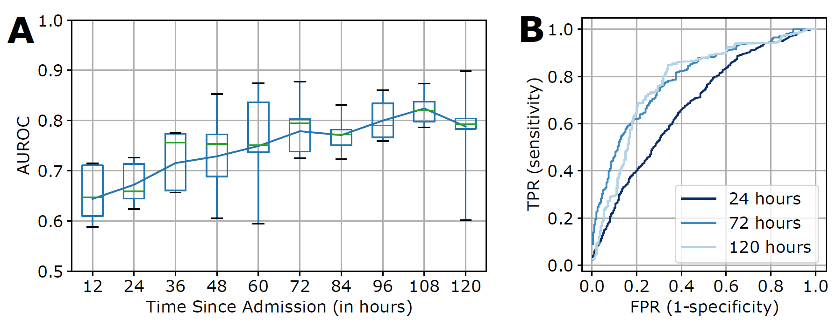
Predict Risk of Requiring Surgery
Turpin et al., Machine Learning Prediction of Surgical Intervention for Small Bowel Obstruction (forthcoming)
Notes:
1 – incorporate temporal information (e.g., time of diagnosis code)
2 -

Slide 15
Was the Decision We’re Learning from Correct?
We learn to replicate surgeons’ decisions
Their risk tolerance depends on many factors, notably the patient’s age
We can’t see counterfactual outcomes (what would have happened?)
The same is true in many other problems, e.g., treatment of retinopathy of prematurity

Slide 16
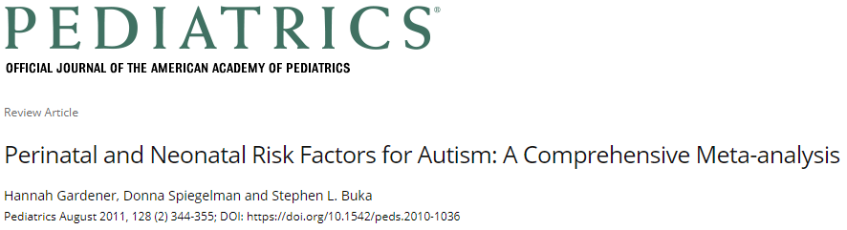
Early Autism Risk Prediction
Perinatal and Neonatal Factors (# studies) | Results Across Studies | Summary Effect Estimate (95% CI)
Presentation
Abnormal presentation (15) | 10−, 5↑ | 1.44 (1.07–1.94)
Breech (4) |  | 1.81 (1.21–2.71)
Other perinatal factors
Cord complications (14) | 13−, 1↑ | 1.50 (1.00–2.24)
Fetal distress (4) | 3−, 1↑ | 1.52 (1.09–2.12)
Birth injury or trauma (6) | 6− | 4.90 (1.41–16.94)
Twins or multiple birth (10) | 7−, 3↑ | 1.77 (1.23–2.55)
Maternal hemorrhage (4) | 3−, 1↑ | 2.39 (1.35–4.21)
Birth weight and size
Total birth weight (decreased) (15) | 12−, 2↑, 1↓
Low birth weight (<2500 g) (15) | 8−, 7↑ | 1.63 (1.19–2.33)
Small for gestational age (10) | 7−, 3↑ | 1.35 (1.14–1.61)
Clinical impression
Congenital malformation (11) | 4−, 7↑ | 1.80 (1.42–2.82)
Apgar score
Low 5-minute Apgar score (8) | 6−, 2↑ | 1.67 (1.24–2.26)
Neonatal Status
Feeding difficulties (3) | 2↑, 1− | 3.35 (1.33–8.40)
Meconium aspirated (3) | 2−, 1↑ | 7.34 (2.30–23.47)
Neonatal medical conditions
Anemia (4) | 3−, 1↑ | 7.87 (1.43–43.36)
ABO or Rh incompatible (5) | 4−, 1↑ | 3.70 (1.90–7.23)
Hyperbilirubinemia (6) |  | 1.87 (1.01–3.47)
We’d like to identify at-risk children more promptly
But, we can only learn from what actually happened…
See who ends up being diagnosed and try to identify them earlier
What about children never identified or lost to follow-up?

Slide 17
We’re Making Good Predictions… Now What do we do?
Sequential Models in Practice

Slide 18
Silent Deployment
Implement the model
Real-time data acquisition and processing (e.g. work from DIHI pipeline rather than curated dataset)
Determine criteria (available e.g. at admission) to trigger its application
Additional data used to refine the model
Secondary / ongoing prospective evaluation
Ensure model generalizes beyond initial data collection
Collection of secondary outcomes / metrics

Slide 19
Passive Intervention (Dashboard)
Notes:
A wide variety of data sources were used to build a predictive model of hypoxaemia events. An explanation (overlaid) is then built for each prediction. Pink features have values that increased risk, whereas green features decreased hypoxaemia risk. The combination of the impacts of all features is the predicted Prescience risk; in this case, the odds are 2.4 × higher than normal. Each feature impact value represents the change in risk when the value of that feature is known versus unknown. Qualitative terms such as ‘low’ or ‘high’ are based on the distribution of a feature value in our dataset.

Slide 20
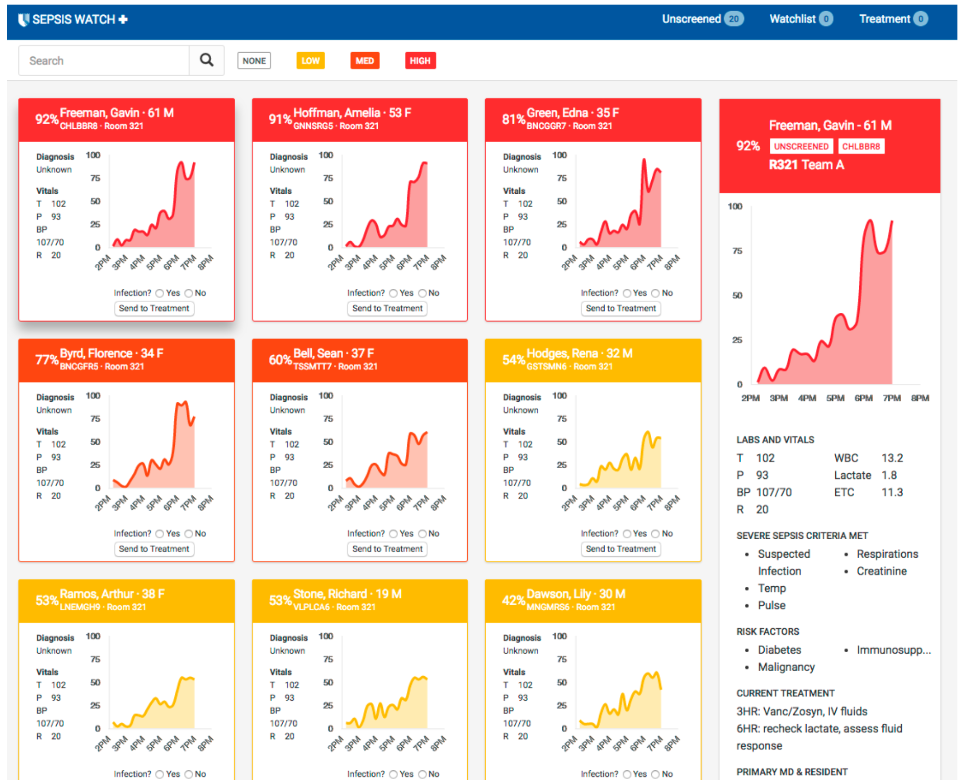
Sepsis Watch Dashboard

Slide 21
Active Intervention
Enroll patients at routine eye exam
Upload fundoscopic images, receive system recommendation (refer or not refer)
Weekly review by ophthalmologist to ensure no referrals missed
Refer if needed and missed by the system
Otherwise, take no action

Slide 22
Active Intervention
In this case, the intervention is implemented at the health system level (routine procedures were changed)
Alternatively, could consider a provider-centered intervention
Or a patient-centered intervention

Slide 23
Let the market decide… ??
https://yourstory.com/mystory/benefits-of-m-health-app-that-you-need-to-know-5kzzliyrni
In short, FDA won’t regulate if it:
Doesn’t provide specific treatment recommendations
Automates routine provider tasks
https://www.fda.gov/medical-devices/device-software-functions-including-mobile-medical-applications/examples-software-functions-which-fda-will-exercise-enforcement-discretion

Slide 24
We Know What to do, but When do we do it?
Sequential Models in Practice

Slide 25
Clinically Meaningful Performance Measures
 | Model-based referral | No model-based referral
Child has autism | Earlier Diagnosis (true positive) | Referral via Current Mechanisms (false negative)
Child does not have autism | Unnecessary Specialist Visit (false positive) | No Action Taken or Needed (true negative)
Decision: initiate referral
*model is NOT used to rule out diagnoses*
Measures of Success:
How much earlier, on average, can we diagnose and intervene?
How many children are unnecessarily referred?
Notes:
And once we’ve developed a model that effectively stratifies every child’s neurodevelopmental risk
We hope to implement it in the EHR and actually use it to trigger referral
But if that’s the goal, we need to think carefully about the impact it’ll have on the health system. We could run down the list of machine learning performance metrics
But those aren’t the measures we really care about. What we’d like to know is:
How much earlier, on average, can we diagnose these conditions?
How many children are incorrectly referred as a result?
Importantly, we need to make sure our model is not being used to rule out diagnoses, which could have the unintended effect of delaying intervention for children who need it
It’s been an incredible year, and we’re excited to continue this work with your support
Thank you
(4 min)

Slide 26
When do we intervene?
How good is model performance at time t?
How concerning are false positives and/or false negatives at time t?
How urgent is intervention at time t?
Considering all these factors, what is our threshold for initiating referral, and does it change over time?
AUC
0.5 1.0 1.5 2.0 2.5 3.0 3.5 4.0 4.5 5.0
Age (years)

Slide 27
When do we intervene?
Some work in this area…
But not enough.
Train model with a loss that is weighted based on time-varying importance of good predictions
Many predictions over time, but only act once
Connection to Secretary problem
AUC
0.5 1.0 1.5 2.0 2.5 3.0 3.5 4.0 4.5 5.0
Age (years)

Slide 28
Discussion Topics
Implementation in the health system
Structure of intervention
Timing of intervention

